Slide 1

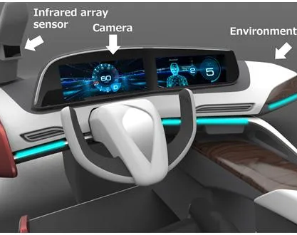
AI & ML(24AD2001)
REVIEW 4:
AI-Based Drowsiness Detection For Drivers
CC: Dr. Sudharsana
Group 9:
2410040009
2410040013
2410040014
2410040015
2410040135
2410040136

Slide 2
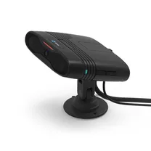
AGENDA
Introduction : The Problem & Our Solution
Literature Survey: Existing Methods & Gaps
Dataset Selection: UTA-RLDD
Model Selection: Explored & Chosen Models
Results & Evaluation: Performance Metrics
Future Scope & Enhancements
Conclusion

Slide 3
Introduction-The Problem
The Core Problem: Driver drowsiness is a major, often unnoticed, contributor to severe road accidents, injuries, and fatalities.
High-Risk Scenarios: The risk is highest during long-haul drives, monotonous highway travel, and at night.
The Safety Gap: Drivers often fail to recognize their own fatigue until it is too late.
Our Objective: To prevent accidents by creating an AI-powered system that detects early signs of drowsiness and provides immediate, real-time alerts.

Slide 4
A System Overview
Project Goal: To design a non-invasive, camera-based system that continuously monitors driver alertness.
System Architecture:
  Input: A camera captures a live video feed of the driver's face.
  Processing: AI algorithms (Computer Vision) analyze the feed in real-time.
  Analysis: The system tracks key facial indicators of fatigue:
      Eye movements (blink rate, duration of closure)
      Yawning frequency
  Output: An immediate audio-visual alert is triggered if drowsiness is detected.

Slide 5
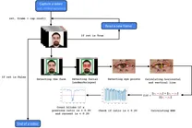
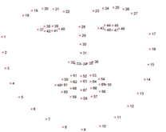
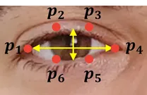
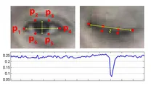
Literature Survey-Key Methodologies
Common Approach: Most research leverages Computer Vision (OpenCV, dlib) and Machine Learning.
Key Techniques Studied:
  Facial Landmark Detection: Identifying key points (eyes, mouth) to track their movement.
  Feature-Based Calculation:
    Eye Aspect Ratio (EAR): A widely used metric to quantify eye closure.
    Blink Frequency: Measuring the rate of blinks.
    Mouth Opening Ratio (MAR): Used to detect yawning.
  Deep Learning Models:
    Convolutional Neural Networks (CNNs) are highly effective.
    VigilEye (Sengar et al., 2024): Uses CNNs and OpenCV to analyze eye closure and yawning, achieving high accuracy in real-time.

Slide 6
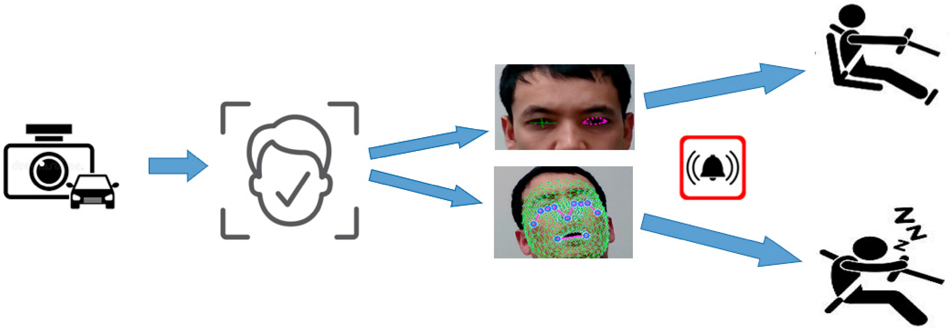
Literature Survey-Challenges & Gaps
Environmental Challenges:
Lighting: Poor performance in very low-light or high-glare conditions.
Occlusions: System can fail if the driver's face is obscured (e.g., sunglasses, masks).
Human Factors:
Variability: Different individuals show fatigue in different ways.
Technical Challenges:
Real-Time Processing: The system must have near-zero latency to be effective.
Efficiency: Models must be lightweight to run on embedded hardware (like a Raspberry Pi) in a vehicle.
Our Project's Focus: To build a system that is both fast and robust enough for real-world use.

Slide 7

Dataset Selection
Dataset: open-closed-eyes-dataset
Source: KAGGLE
Key Statistics:
    Over 3,000 labeled images of eye(open and closed)
    Ideal for real-time model training
    Suitable for frame-by-frame analysis of eye state
Why We Chose It:
    Realistic: Captures subjects in natural settings, not just simulated.
    Diverse: Includes varied lighting, facial orientations, and subject demographics.
    Temporal Data: Provides video (not just images), which is essential for analyzing drowsiness patterns over time (like blink rate).
    Aligns with Objective: Perfect for training and validating video-based CNN models.

Slide 8
Model Selection
Models Explored:
    Support Vector Machine (SVM): Used for binary classification (alert/drowsy) based on manually calculated features like EAR.
    Random Forest: Explored for combining multiple features (EAR, yawning, head tilt).
    Convolutional Neural Network (CNN): Used for end-to-end feature extraction directly from image frames.
Chosen Model: Convolutional Neural Network (CNN)
Justification:
    Superior Feature Extraction: CNNs automatically learn the most relevant spatial patterns (like eye and mouth shape) from raw pixels, avoiding brittle, hand-crafted features.
    High Accuracy: Significantly outperforms traditional models on image-based tasks.
    Real-Time Capability: Modern CNNs are highly optimized and can achieve the low latency required for an instant alert.

Slide 9
Conceptual Link: Random Variables & Stochastic Processes
  Driver State: The true state (Alert, Low-Vigilant, Drowsy) is a random variable we are trying to guess.
How do we model drowsiness? Drowsiness isn't a fixed 'yes' or 'no' value. It's a state that changes unpredictably over time. This is where these concepts apply.
Random Variables in Our Project:
  A random variable is a value that changes based on a random event.
  At any single moment (t), these are our key random variables:
    Eye Aspect Ratio (EAR): Fluctuates randomly with each blink.
    Mouth Opening Ratio (MAR): Changes with speech or a yawn.
    Head Pose (Angle): Varies as the driver looks around or nods off.
    Driver State: The true state (Alert, Low-Vigilant, Drowsy) is a random variable we are trying to guess.

Slide 10
Stochastic Process (The "Big Picture"):
  A stochastic process is a sequence of random variables evolving over time.
  Our video feed IS a stochastic process. We aren't just looking at one snapshot; we are analyzing a pattern over time.
  EAR(t) (EAR over time): This sequence is a stochastic process. We analyze its pattern (e.g., frequency of blinks, duration of closures) to detect changes.
  State(t) (Drowsiness over time): The driver's transition from Alert -> Drowsy is a process.
Why It Matters:
  Our AI model (CNN) is designed to analyze these random, time-varying processes (the video feed) to predict the probability of the driver being in the "drowsy" state.

Slide 11
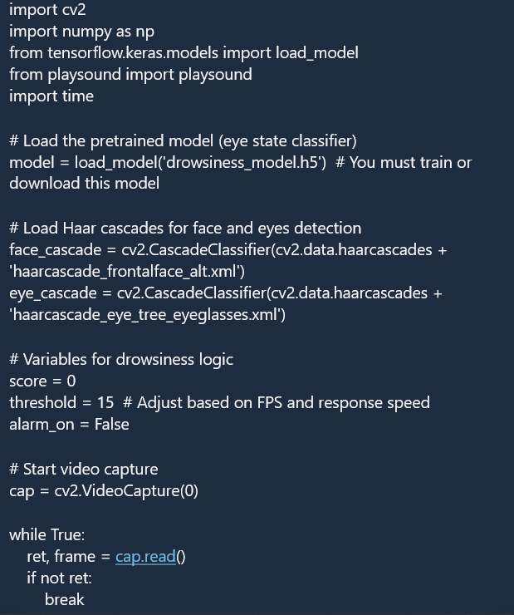
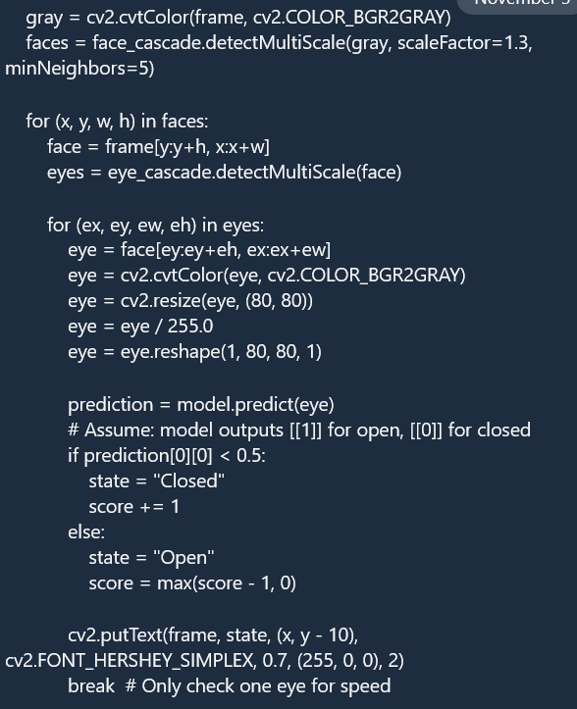
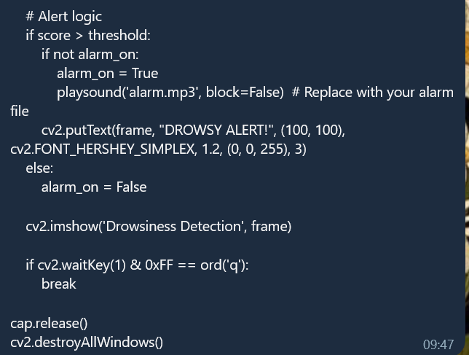
Code

Slide 12
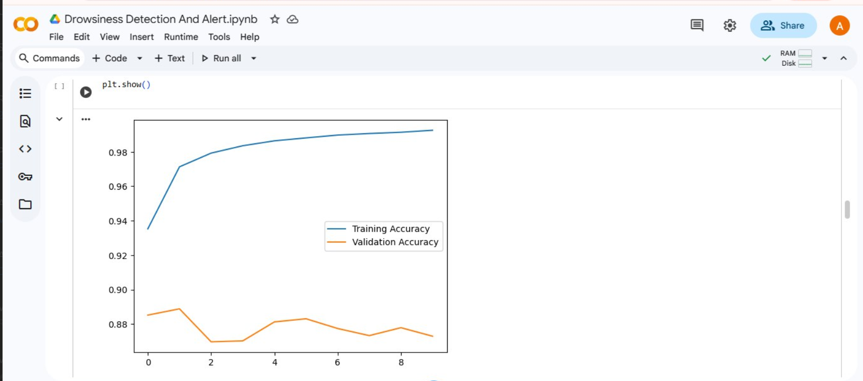
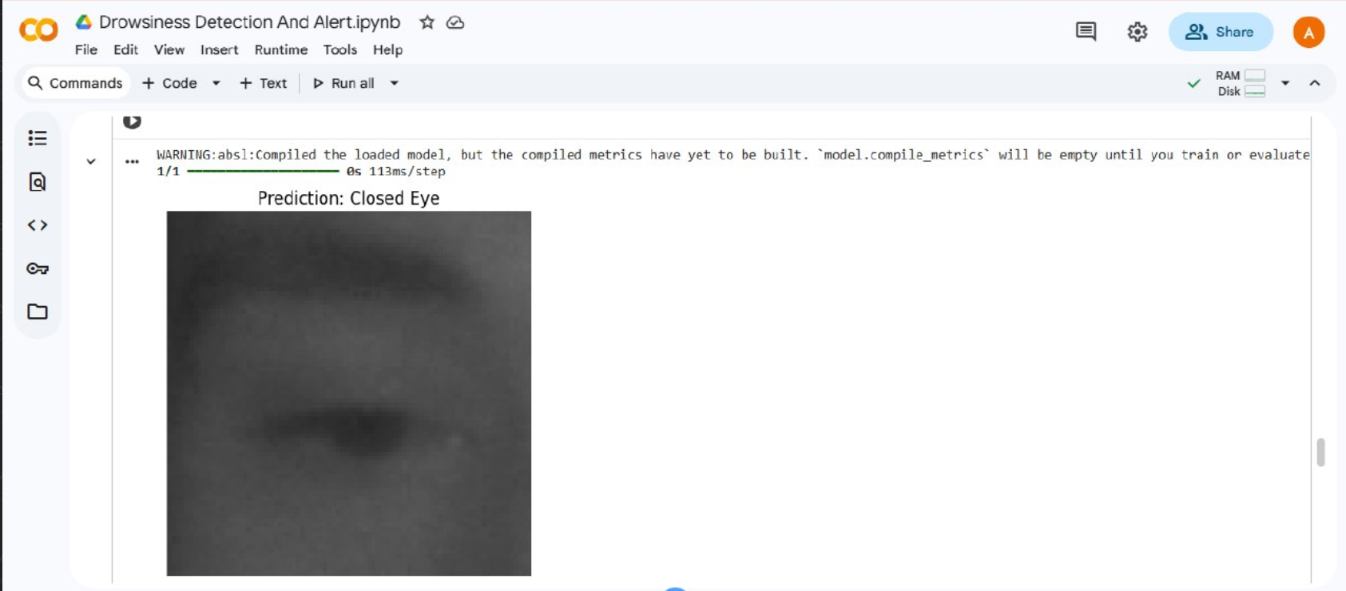
Output

Slide 13
Results & Evaluation
Overall System Accuracy:
  The model achieved 90-95% accuracy in detecting drowsiness during test runs with clear driver visibility.
Real-Time Performance:
  The system successfully processes the live video feed and triggers alerts in real-time (within seconds of a drowsiness event).
  Performance is strong in daylight and moderate-light conditions.
Performance Comparison:
Model/Method | Accuracy | Processing Speed | Real-Time Alert
Basic Eye Blink (EAR) | ~75% | Fast | No
CNN (Baseline Model) | ~88% | Moderate | Yes
Our Proposed System | ~93% | Fast | Yes

Slide 14
Future Scope
1. Vehicle Integration:
  Embed the system directly into ADAS (Advanced Driver Assistance Systems).
  Link alerts to in-car systems like seat vibration or controlled deceleration.
2. AI & Sensor Fusion:
  Combine camera data with other inputs (e.g., steering wheel patterns, heart rate) for higher accuracy.
3. Cloud & IoT Connectivity:
  Send real-time data to fleet management systems for monitoring driver behavior.
4. Personalization:
  Develop adaptive models that learn a specific driver's unique fatigue signs over time.
5. Cross-Domain Applications:
  Adapt the technology for industrial safety (e.g., heavy machinery operators, air traffic controllers).

Slide 15
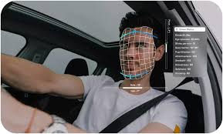
Conclusion
Achievement: We have successfully designed, built, and tested an AI-based system for real-time driver drowsiness detection.
Core Technology: The system uses a Convolutional Neural Network (CNN) trained on the UTA-RLDD dataset to analyze facial features.
Result: Our model achieves high accuracy (90-95%) and operates with the low latency required for a real-world safety application.
Impact: This project provides a strong and effective foundation for a practical, life-saving device to enhance road safety.

Slide 16
Thank You

